Slide 1
Diploma in Packaging Technology
Filling Equipment
Notes:
Introduction
Welcome
Background to FPC
Important contribution to the food industry

Slide 2
Overview
Weights and Measures
Liquid fillers
Paste fillers
Solis fillers

Slide 3
Weights & Measures
Average and Minimum Fill systems
Packers rules
Average weight not less than stated weight
No more than 2.5% underweight by TNE (T1)
No packs underweight by more than twice TNE (T2)
Appropriate measurement equipment

Slide 4
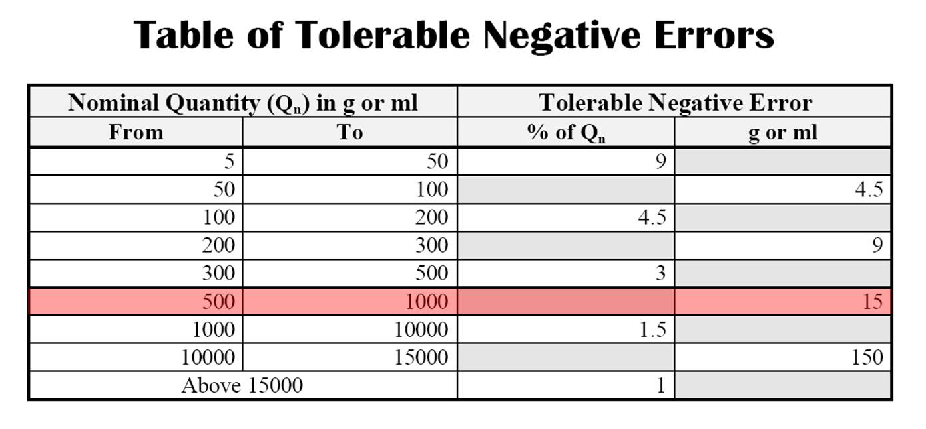
TNE

Slide 5
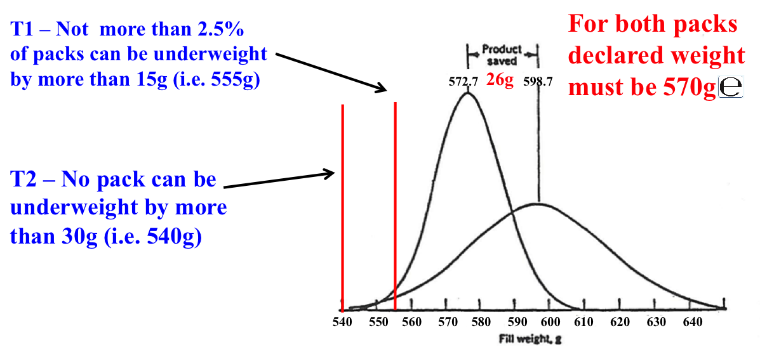
Declared Weights

Slide 6
Product
Physical format
Solid liquid paste
Fragility
Hygiene
Safety

Slide 7
Liquid & Paste filling
Viscosity
Foaming
Oxidation
CO2 loss
Shear resistance

Slide 8
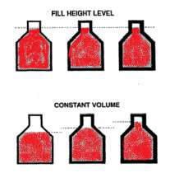
Liquid Fillers
Constant Level
Constant Volume

Slide 9
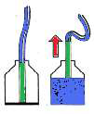
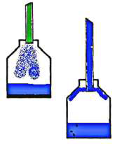
Top to bottom filling and bottom up filling

Slide 10
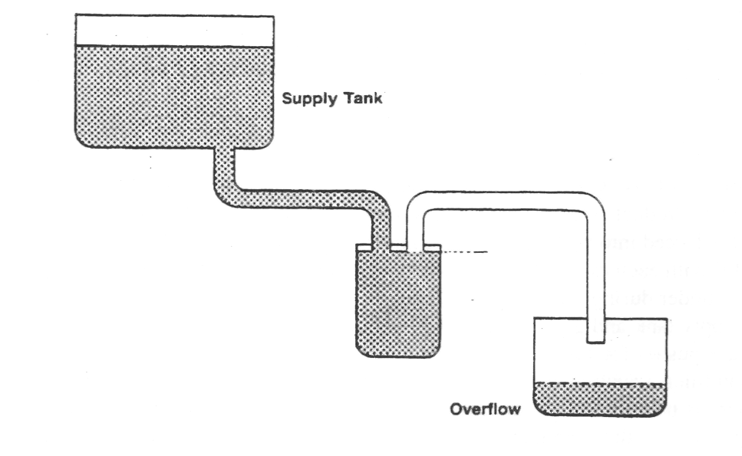
Gravity Fillers

Slide 11
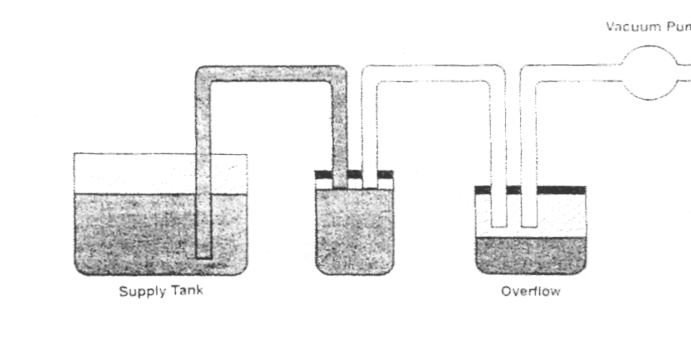
Vacuum Fillers

Slide 12
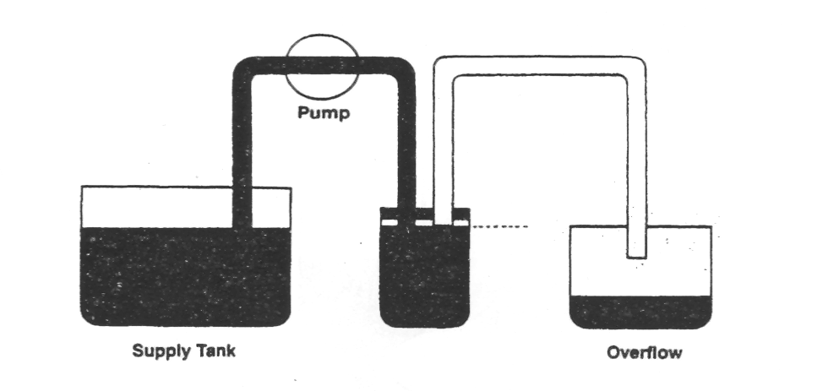
Pressure Fillers

Slide 13
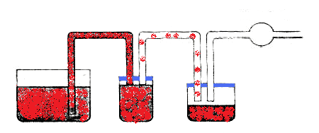
Pressure and Gravity Fillers
Pump
Vacuum pump
Supply tank
Overflow

Slide 14
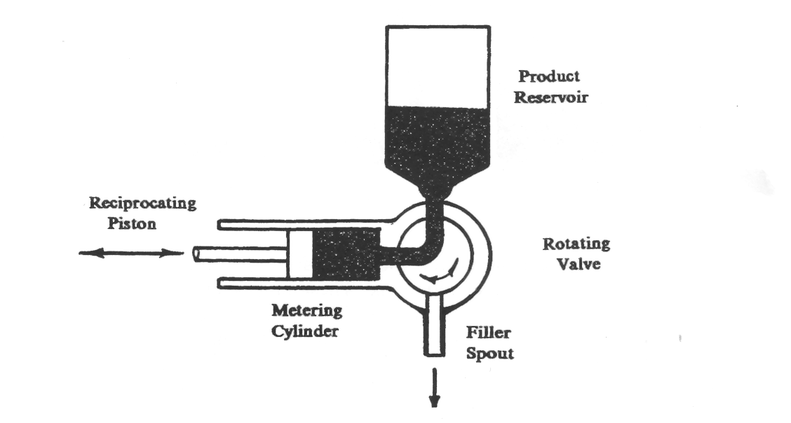
Piston Fillers

Slide 15
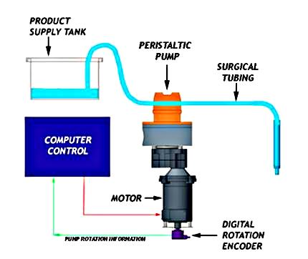
Metering Pump
Filling
head

Slide 16
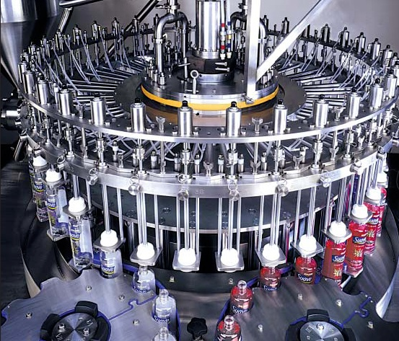
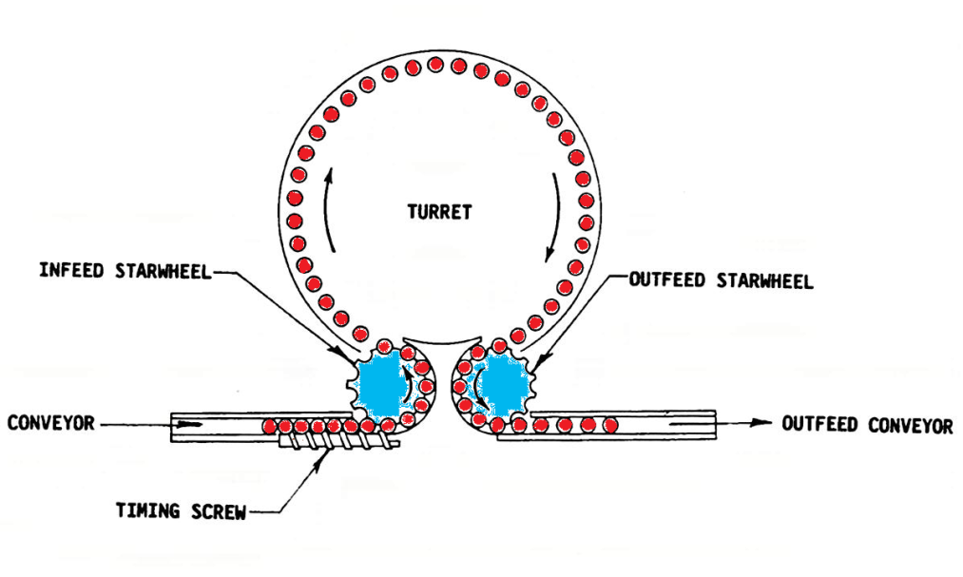
Rotary or In Line Fillers
Rotary 500-2000cpm

Slide 17
Liquid fillers
Excess product removal
Require good seals
Level detection
Sonic

Slide 18
Recap Package Characteristics
Glass Jar / Bottle
Plastic bottle
Liquid paperboard carton
Can

Slide 19
Fillers need to think about :
Product characterises
Package characteristics
Filler type

Slide 20
Dry Filling
1.Volume, cup auger fillers
Density impact.
2. Weight, weighting systems
3. Count

Slide 21
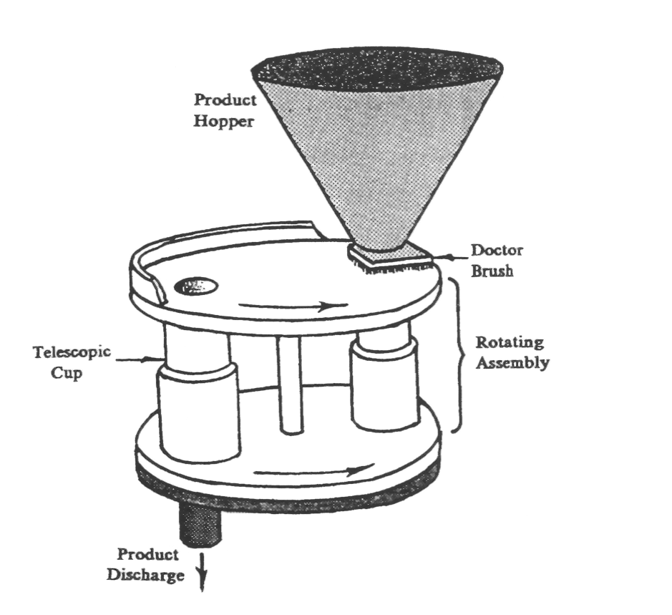
Cup Filler: 1. Volume

Slide 22
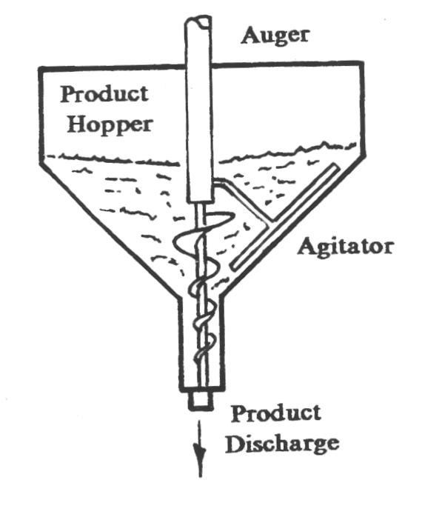
Auger Filler: 1. Volume

Slide 23
Solids filling
Single filler
Rotation
Scale
Drop and top up
90% quick drop
Topped up

Slide 24
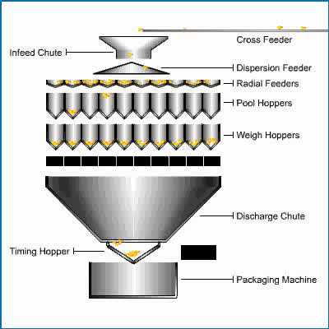
2. Weight Systems
https://www.youtube.com/watch?v=kfBp2Vz0SRU

Slide 25
3. Counting Systems
Counts individual items
Electronic eyes, disks,
https://www.youtube.com/watch?v=be3ugunC0H4
https://www.youtube.com/watch?v=XKUiaNWFk3w
https://www.youtube.com/watch?v=NnWRQpuPT7o

